Slide 1
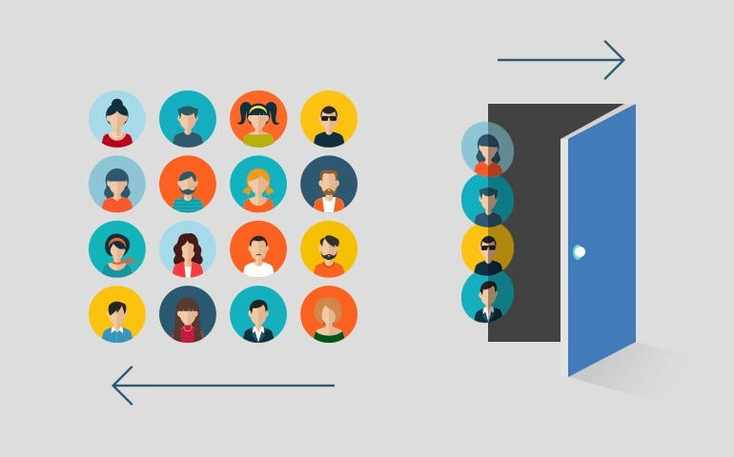
Customer churn analysis
IT003 - MANAV AGHERA
IT076 - NIVEDITA THAKUR

Slide 2
What is churn analysis?
Customer churn, also known as customer attrition, is the loss of clients or customers.
It is the rate at which customers are leaving a business and taking their subscription dollars elsewhere.
A high churn means that a higher number of customers no longer want to purchase goods and services from the business.

Slide 3
WHY IS churn analysis IMPORTANT?
There’s no more vital metric for a SaaS company to keep track of than churn.
Churn analysis is used to evaluate a company’s customer loss rate in order to minimized it by assessing their product and how people use it.
Difficulty of bringing enough new customers in to plug the holes in the ship.
High churn rates are more likely to compound over time.

Slide 4
John Egan, who was a growth engineering leader at Pinterest through their highest growth years, analyzed user activity to determine when to intervene and prevent churn.
They applied this analysis to build a reengagement focused email.
An app notification or email was sent to users who crossed a 20% churn probability threshold.

Slide 5
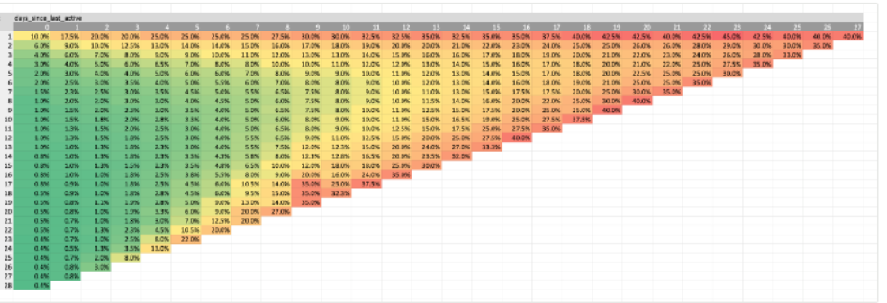
The horizontal axis is the number of days since the individual was last active
The vertical axis is the number of days the user was active out of the past 28 days.
An individual cell is the percent probability of that user churning out and not being active the following month.

Slide 6
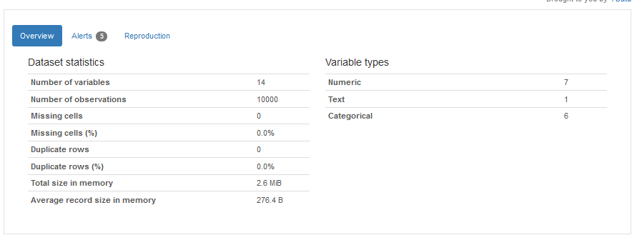
dataset
Cleaned the data, handled categorical values, normalized the data, and addressed imbalanced data.

Slide 7
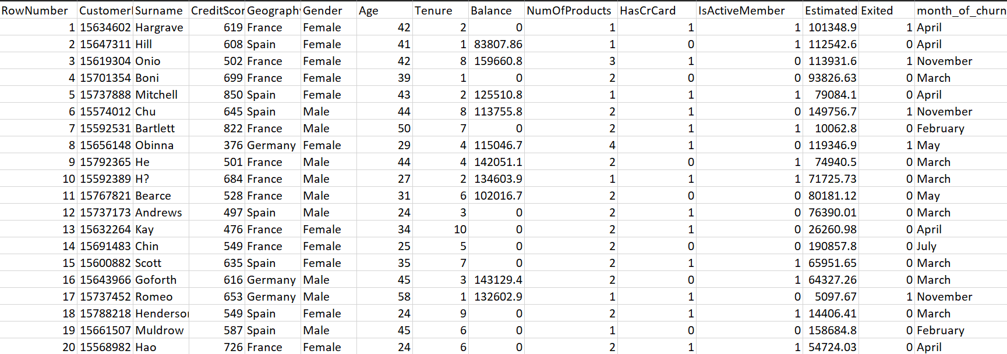
first 20 rows of dataset

Slide 8
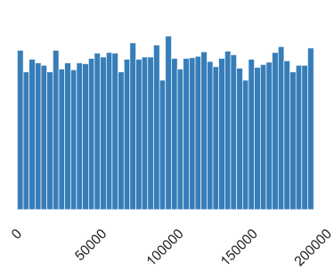
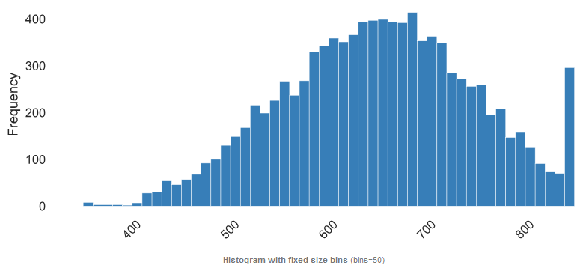
Exploratory Data Analysis
Estimated Salary
Credit Score
Frequency

Slide 9
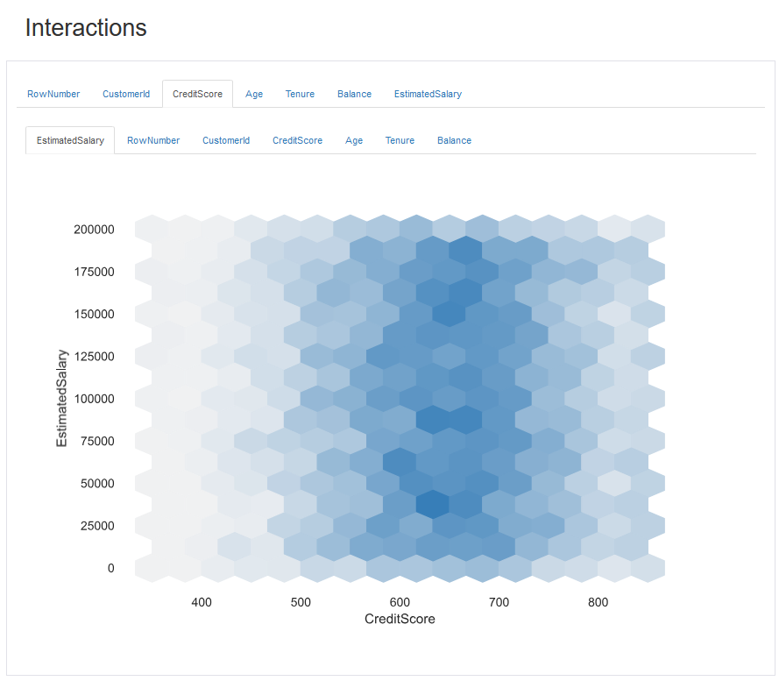

Slide 10
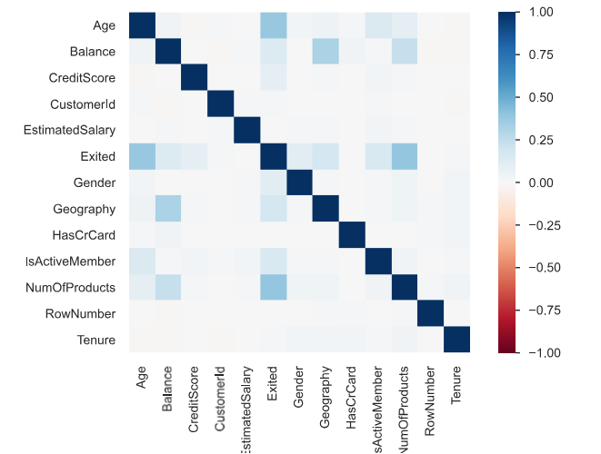
Correlations

Slide 11
MODEL DEVELOPMENT and evaluation
Implement and train various machine learning algorithms: logistic regression, decision trees, random forests, and XGBoost.
Assess the performance of each model using metrics such as accuracy, precision, recall, F1-score.
Use the best performing algorithm to train the model and predict customer will churn or not.

Slide 12
MODEL DEPLOYMENT
The selected model is integrated into a user-friendly interface to enable real-time predictions for new customer data.
The application will process customer data inputs and instantly predict whether customer will churn or not based on current data.
In addition to likelihood of customer churn, it is important for company to know when customers tend to churn most.

Slide 13
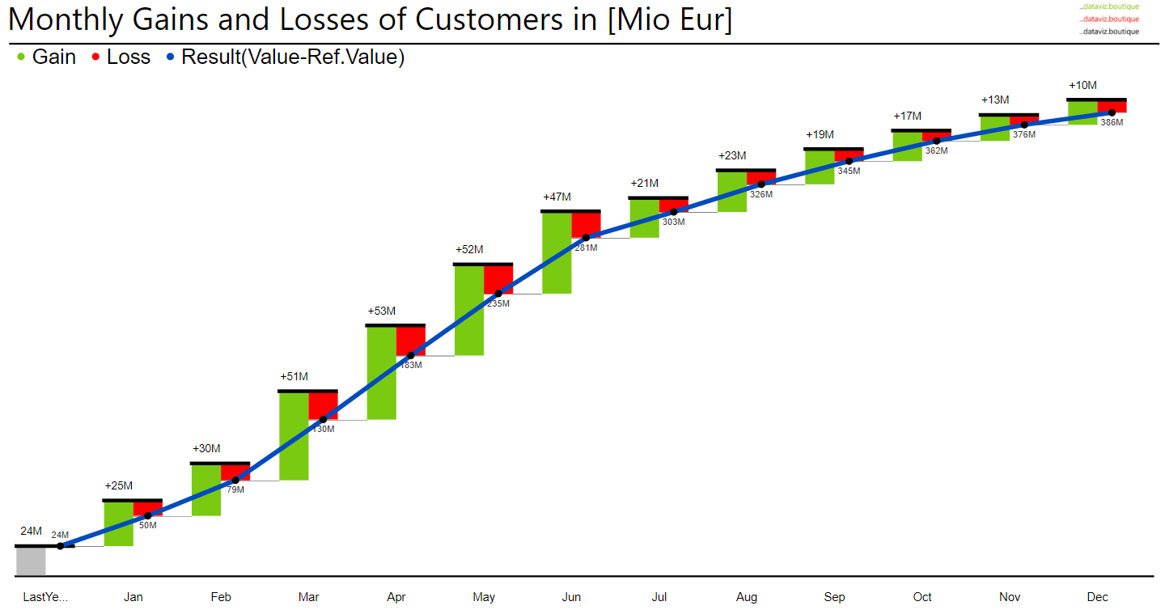
The model will also graphically represent the monthly churn rate to allow companies to apply appropriate retention policies.

Slide 14
RESOURCES
Customer churn analysis: One of SaaS’ most important processes
https://www.kaggle.com/datasets/adammaus/predicting-churn-for-bank-customers?resource=download
https://www.reforge.com/artifacts/churn-probability-analysis-from-pinterest#81811678-5999-4814-bc38-450a8e33f14b
https://userpilot.com/blog/customer-churn-analysis/

Slide 15
THANK YOU

